Slide 1
WEB APPLICATION DEVELOPMENT TRAINING
INTRODUCTION TO DATABASE

Slide 2
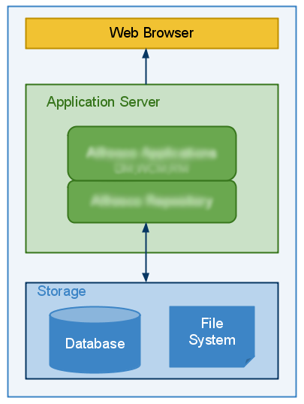

Slide 3
Introduction to Database
A database is a collection of data organized in a particular way
Physically, database servers are dedicated computers that hold the actual databases and run only the DBMS and related software
Access to database is provided by DBMS
A database management system (DBMS) is a computer software application that interacts with the user, other applications, and the database itself to capture and analyze data
Commonly used DBMS are MySQL, Oracle etc
SQL, pronounced “SeQUEL” is a standard language for accessing databases.

Slide 4
Relational Database
A relational database is a database that organizes information into one or more tables.
A table is a collection of data organized into rows and columns. Tables are sometimes referred to as relations.
A column is a set of data values of a particular type.
A row is a single record in a table.

Slide 5
Common Relational DBMS
SQLite Open Source SQL database used for databases in cellphones, PDAs, MP3 players, set-top boxes, and other electronic gadgets.
MySQL :most popular open source SQL database typically used for web application development, and often accessed using PHP.
Oracle DB: owned by the Oracle corporation and the code is not open sourced. used for large applications, particularly in the banking industry. Most of the world’s top banks run Oracle applications because Oracle offers a powerful combination of technology and comprehensive, pre-integrated business applications, including key functionality built specifically for banks.

Slide 6
Common Relational DBMS
PostgreSQL: an open source SQL database that is not controlled by any corporation typically used for web application development.
SQL Server: owned by Microsoft. Like Oracle DB, the code is also close sourced.
SQL Server is mainly used by large enterprise applications. The major difference between Oracle and SQL Server is that SQL Server only supports the Windows Operating System.

Slide 7
Definitions
Database: A database is a collection of tables, with related data.
Table: a matrix with data. A table in a database looks like a simple spreadsheet.
Column: One column (data element) contains data of one and the same kind, for example the column postcode.
Row: An entry or record, is a group of related data, for example the data of one subscription.
Redundancy: Storing data twice, redundantly to make the system faster.
Primary Key: A primary key is unique.
Foreign Key: A foreign key is the linking pin between two tables.

Slide 8
SQL Syntax
Most of the actions you need to perform on a database are done with SQL statements.
SQL keywords are NOT case sensitive: select is the same as SELECT
Some database systems require a semicolon at the end of each SQL statement.
Semicolon is the standard way to separate each SQL statement in database systems that allow more than one SQL statement to be executed in the same call to the server.

Slide 9
SQL Comments
Comments can be used to explain sections of SQL statements.
Comments can also be used to prevent execution, when testing alternative SQL statements.
Single line comments start with –
Multi-line comments start with /* and end with */.
Any text between /* and */ will be ignored.
Notes:
SELECT * FROM Customers -- WHERE City='Berlin';

Slide 10
Structured Query Language SQL
SQL can be primarily divided into two parts: The Data Manipulation Language (DML) and the Data Definition

Slide 11
DDL
The DDL part of SQL permits database tables to be created or deleted. It also define indexes (keys), specify links between tables, and impose constraints between tables.
CREATE DATABASE - creates a new database
ALTER DATABASE - modifies a database
CREATE TABLE - creates a new table
ALTER TABLE - modifies a table
DROP TABLE - deletes a table
CREATE INDEX - creates an index (search key)
DROP INDEX - deletes an index

Slide 12
DML part of SQL
The query and update commands form the DML part of SQL
SELECT - extracts data from a database
UPDATE - updates data in a database
DELETE - deletes data from a database
INSERT INTO - inserts new data into a database

Slide 13
SQL Statements
Database tables can be added with the CREATE TABLE statement.
Syntax is CREATE DATABASE my_db;
CREATE TABLE table_name
(
column_name1 data_type(size),
column_name2 data_type(size),
column_name3 data_type(size),
....
);

Slide 14
SQL ALTER Table Statement
The ALTER TABLE statement is used to add, delete, or modify columns in an existing table.
To add a column in a table, use the following syntax:
ALTER TABLE table_name
ADD COLUMN column_name datatype
Syntax to delete a column in a table:
DROP COLUMN column_name

Slide 15
SQL ALTER Table Statement
To change the data type of a column in a table, use the following syntax:
ALTER TABLE tablename
CHANGE COLUMN oldcolumn newcolumn newDatatype (size); *
To change the name of a table
RENAME TABLE oldtable TO newtable;
To rename a column
ALTER TABLE tablename
CHANGE COLUMN oldcolumn newcolumn Datatype (size);
Notes:
If the name of the col;umn is not changing, both oldname and newcolumn name will remain the same

Slide 16
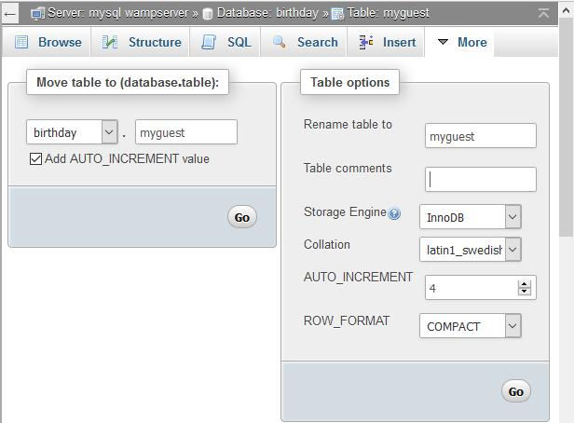
Table Comments
In PHPMyAdmin, Selct the table, go to Operations, enter the comments and save

Slide 17
SQL Constraints
SQL constraints are used to specify rules for the data in a table.
Constraints can be specified when the table is created (inside the CREATE TABLE statement) or after the table is created (inside the ALTER TABLE statement).
CREATE TABLE table_name
(
column_name1 data_type(size) constraint_name,
column_name2 data_type(size) constraint_name,
column_name3 data_type(size) constraint_name,
....
);
ALTER TABLE tablename ADD PRIMARY KEY(column Name);

Slide 18
SQL NOT NULL Constraint
The NOT NULL constraint enforces a column to NOT accept NULL values.
The NOT NULL constraint enforces a field to always contain a value. This means that you cannot insert a new record, or update a record without adding a value to this field

Slide 19
Example
CREATE TABLE Persons
(
pid int NOT NULL ,
lastname varchar(255) NOT NULL,
firstname varchar(255),
address varchar(255),
city varchar(255)
)

Slide 20
Table Datatypes
Data type Description
CHARACTER(n) Character string. Fixed-length n
VARCHAR(n) or
BOOLEAN Stores TRUE or FALSE values
INTEGER(p) Integer numerical (no decimal). Precision p
SMALLINT Integer numerical (no decimal). Precision 5
INTEGER Integer numerical (no decimal). Precision 10
DECIMAL(p,s) Exact numerical, precision p, scale s. Example: decimal(5,2) is a number that has 3 digits before the decimal and 2 digits after the decimal
FLOAT(p) Approximate numerical, mantissa precision p. A floating number in base 10 exponential notation. The size argument for this type consists of a single number specifying the minimum precision
REAL Approximate numerical, mantissa precision 7
FLOAT Approximate numerical, mantissa precision 16
DOUBLE PRECISION Approximate numerical, mantissa precision 16
DATE Stores year, month, and day values
TIME Stores hour, minute, and second values
TIMESTAMP Stores year, month, day, hour, minute, and second values

Slide 21
Introduction to HeidiSQL
Install HeidiSQL
Explore HeidiSQL and compare with PHPMyadmin
Pay attention to ENUM, TINYINT ENUM is used to define custom values. It has to be the exact option defined.

Slide 22
DROP, TRUNCATE
To empty a database table, use the TRUNCATE statement.
Syntax is : TRUNCATE table_name;
To Delete the entire table (no remedy!) use the DROP statement. Syntax is:
DROP table table_name

Slide 23
AUTO INCREMENT AND RESET
When you delete one or more records from a table, if there is an auto field, the increment value continues from the last record.
You can reset the auto increment before adding new records.
To do this in HeidiSQL, see the next slide:
Change the auto increment value to the desired number

Slide 24
